Slide 1
Bottom Line Improvement through Promo Effectiveness

Slide 2
Managing Director at Impact Analytics
Recently recognized by Forbes as one of 25 machine learning startups to look out for in 2019
Named the fastest growing analytics firm in 2018 in Inc. 5000
Works with multiple Private Equity-owned clients, Fortune 500 and leading clients in grocery, retail, health care, pet supplies, fashion, hospitality, department stores & franchises.
PRITHVIK KANKAPPA
Prithvik.Kankappa@impactanalytics.co

Slide 3
PrintComm
President / Owner
Over 35 years of experience in the Printing Industry
Extensive knowledge in direct mail and marketing
KEVIN NAUGHTON
knaughton@printcomm.com

Slide 4
AGENDA
Common problems and challenges b2c marketers face
How can good promo design increase margins?
Identifying toxic promos: Are there offers that create negative margin?
Offers for new customer acquisition
Segment Specific offers
AI applications

Slide 5
What are some of the common problems and challenges B2C marketers face?

Slide 6
Less than optimal current state of promos at many retailers leading to continuous margin leakage
Unclear objective
Poor governance
Haphazard design
Toxic promos prevail
Performance unknown
Promo support dollars are not measured for ROI
Haphazard usage of communication channels
Competitors misunderstood / not tracked
Notes:
Unclear objective - Promo objective not clearly articulated to all stakeholders
Poor governance - Multiple stakeholders with no clear accountability
Haphazard design - Promos are designed without a clear objective or estimation / simulation of potential impact
Toxic promos prevail - Promos not tracked and measured leading to a set of promos which hurt more than they help
Performance unknown - Non sales and margin dollar effects not measured, e.g. cannibalization, pull-forward and halo
Promo support dollars are not measured for ROI - Whether support dollars are paying back more then spend
Haphazard usage of communication channels – With no tracking of which channels have the best marketing ROI
Competitors misunderstood / not tracked – No tracking of how competitors’ promos can affect own promos

Slide 7
How can good promo design increase margins?

Slide 8
A Robust Promo Effectiveness Program
Clear objectives
Clear ownership
Robust performance review process
Maximum impact promo communication
Competition intelligence
Employee insights
Notes:
Clear objectives – Promos are developed, monitored and measure against plans to ensure an increase in net margin dollars
Clear ownership - All stakeholders are part of promo governance council
Robust performance review process – Governance council regularly reviews performance of promos, culling out toxic promos and leveraging winning promos
Maximum impact promo communication – Best communication channels used based on analysis
Competition intelligence – Governance council regularly reviews changing promo strategies of competitors
Employee insights – Field wisdom of employees tapped into to build better promos

Slide 9
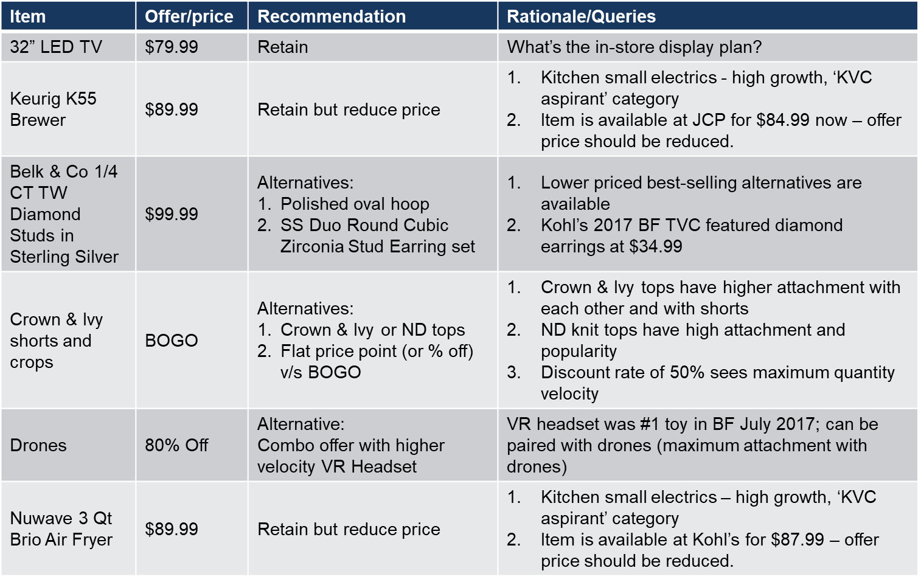
Offer Selection
Which offers should go into the flyer?
Offer merit
KVC centered offers
Account for seasonality
Competition assessment
PROMO DESIGN
Notes:
Which offers should go into the flyer?
Offer merit – Offers which have greater predicted performance in terms of lifts
KVC centered offers – Traffic Drivers, Basket Builders and Margin Gatherers
Account for seasonality – Department level variation of what department/offers/offer types attracted maximum customers
Competition assessment –
Monthly focus areas, price points, offer types

Slide 10
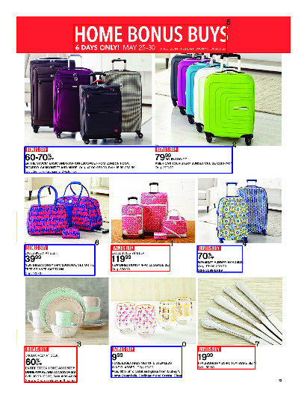
Offer Positioning
Where should each offer be positioned?
Cover page analysis
Sequencing of categories within marketing brochure
Sequencing of offers in each page
PROMO DESIGN
Notes:
Where should each offer be positioned?
Cover page analysis – Based on offer merit, seasonal focus and competition assessment
Sequencing of categories within marketing brochure – Does relative placement of categories effect performance?
Sequencing of offers in each page – Are there any specific areas within the brochure that grab more attention? Which offers should be placed where on a page?

Slide 11
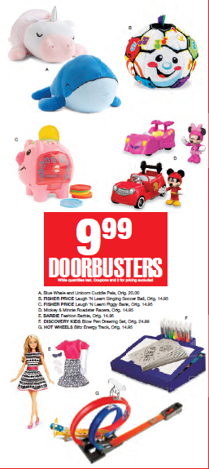
Image Selection
How should each offer be represented?
Do “hero images” work better than grid representation?
Do personalized pictures work better than vanilla product pictures
PROMO DESIGN

Slide 12
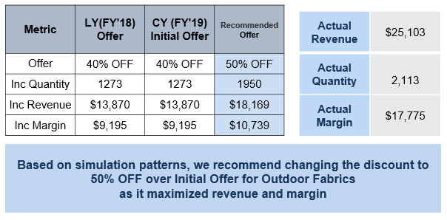
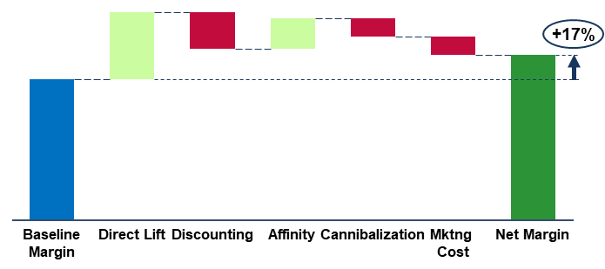
PROMO DESIGN
Notes:
Collateral design is a complex decision that is needed to improve promo effectiveness
Some of the questions can be answered by analytics, others require test and learn
Second image: Factor in direct and indirect effects
Net impact of offers/discounts/promos, are adjusted for
Direct effects – Direct lift and Discounting cost
Indirect effects - Affinity, Cannibalization, etc.
will be generated for each category / item / offer type level
Impact of seasonality, markdowns, coupons need to be delineated to generate baseline values

Slide 13
Are there offers that create negative margin? How can offers drive improved profitability?

Slide 14
Promotions drive ~30% of retail sales but 40% of these are toxic - lack of understanding of effectiveness measurement and profitability
Examples: Neiman Marcus offers more discounts, but saw a margin drop of 19%
Promotions deliver intuitive benefits to retailers such as increased customer pull, bigger purchase baskets and an overall uplift in sales, the first orders – these are well measured and known
What is unknown is the net margin impact of a promotion – how does it impact the bottom-line?
Second order effects of promotions are usually not measured and basket impact not accounted for
To correctly calculate baseline and net promo lift, one needs to isolate the effects of
1. Pricing changes 2. Marketing efforts 3. Peaks due to seasonality and events 4. Impact of other promos

Slide 15
CLIENT BACKGROUND
CURRENT SITUATION
CHALLENGES
Top 3 pet food retailer in US
400+ stores across 25 states
The stores are focused on being neighborhood pet supply "supermarkets“
50,000+ products across 600 brands
2,500+ promotions/quarter 500+ promotions/month
Toxic promotions hurting bottom line upwards of $ 5 MN
Outdated IT process and lack of a governance structure
Measurement, tracking and improvement of promos has been missing
CASE STUDY
Notes:
Current Situation
2,500+ promotions/quarter 500+ promotions/month
Toxic promotions hurting bottom line upwards of $ 5 MN
Vendor/manufacturer negotiations on discount contribution based on Merchant’s instinct
Metrics for measuring true effect of promo not based on science, leading to misalignment amongst stakeholders
Challenges
Twice, the client has undertaken a process to eliminate toxic promos but the promos have seeped back because of an outdated IT process and lack of a governance structure that lacked accountability for overall promo performance
In addition, the analytics behind promos has been lacking: measurement, tracking and improvement of promos has been missing

Slide 16
CLIENT NEED
CHALLENGE
SOLUTION
Promos have to be measured against set of defined factors
A solution has to be permanent enabled through IT, repeatable analytics and governance.
Change EBITDA trajectory quickly while building an enabled IT solution.
Getting merchants to use the tools.
Promo response model
IT system (promo response tool) that allows vendors to enter promos, merchants to simulate promos and approve and do post-promo measurement through dashboards
Governance process
CASE STUDY
Notes:
Need:
Intrinsically, the client is aware what to do: Promos have to be measured against set of defined factors: e.g., increase in sales and margin dollars (taking into account cannibalization and halo and additional factors such as increase foot traffic, help new product launches etc.)
A solution has to be permanent enabled through IT, repeatable analytics and governance.
Challenge:
To change EBITDA trajectory quickly while building an enabled IT solution.
Getting merchants to use the tools. While IA builds the promotion evaluation tool, IA has also collaborated with the merchants to ensure analytics are used to select value accretive tools
Solution:
Promo response model: allows merchants to simulate promos’ impact before they take place and select only value accretive promos
IT system (promo response tool) that allows vendors to enter promos, merchants to simulate promos and approve and do post-promo measurement through dashboards
Governance process that ensures merchants, operations and finance work together to ensure

Slide 17
Overall Impact: Promotion response tool helped save client $4.5M in bottom-line
Identified 700+ toxic promotions across 3 months
Entire set of quarterly promotions were scrapped based on recommendations
Enabled merchants to identify value in slow moving items
Redefined process of bundling items together to create a promotional offer
Improved margin from good promos by running at optimal price point
$2M
Improved margin from good promos by running at optimal price point
$2M
Savings on marketing cost due to smaller number of promos
$0.5M
CASE STUDY

Slide 18
What kinds of offers work best for new customer acquisition?

Slide 19
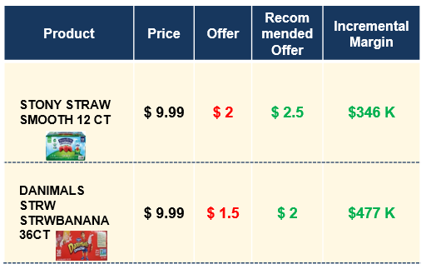
18,000+ new shoppers acquired due to this promo
NEW CUSTOMER ACQUISITION

Slide 20
NEW CUSTOMER ACQUISITION
Notes:
Huge increase in ROI per store in September and October compared to other months due to store cluster approach
Increased redemption rates for a lesser discount percentage

Slide 21
AI Applications

Slide 22
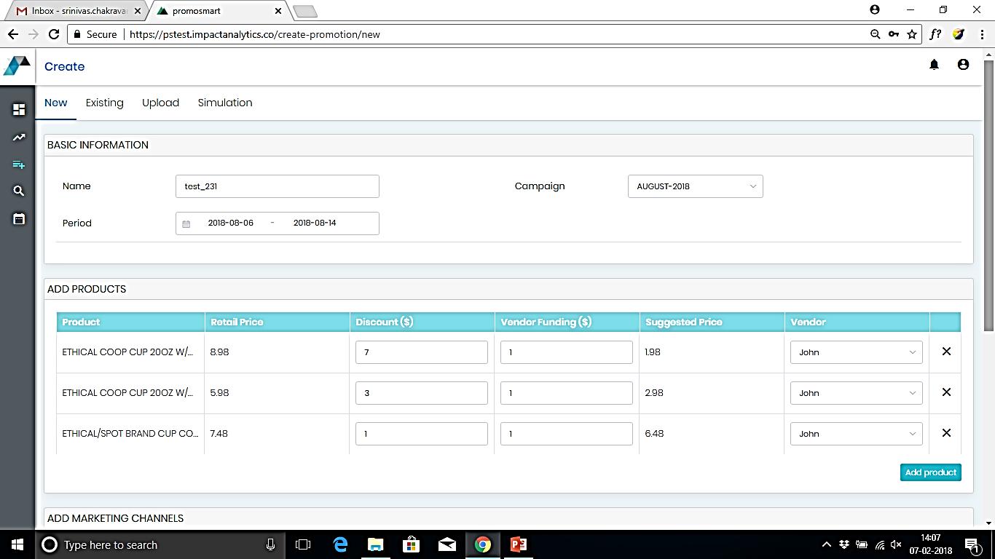
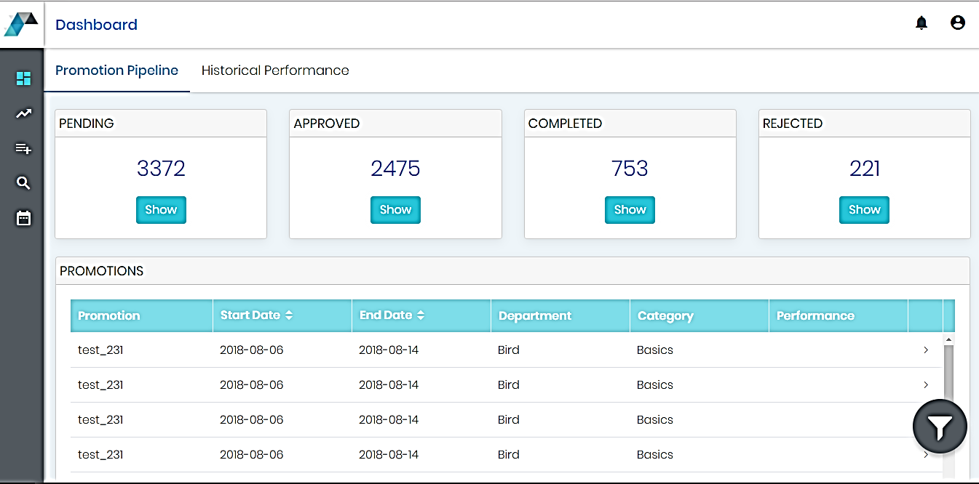
Promo Simulation
Simulate promotion response based on design parameters
1
Flexibility of Formats
Simulation for three types of promotions - % off, $ off and BoGo
2
Marketing Calendar
3
Single source of truth around upcoming campaigns and approved promotions
Robust Process
4
Business relevant work-flow with appropriate approval / checks in place for timely execution
Report and Learn
5
Deep dive reports to help understand what works
AI AND MACHINE LEARNING

Slide 23
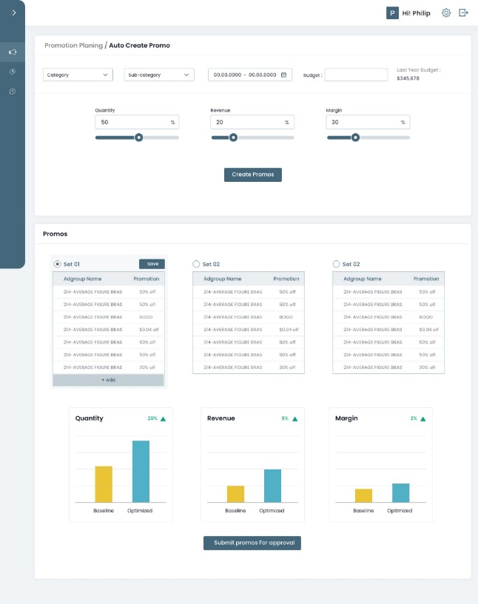
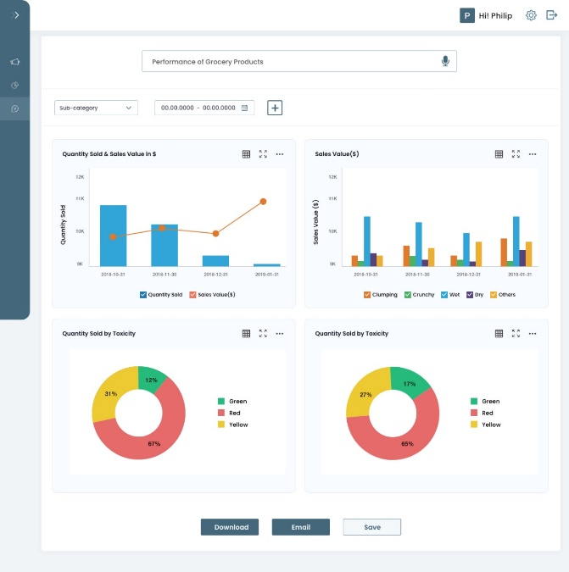
Key AI and automation features available
Promo Optimization: Smart auto-analysis and suggestion of promos to achieve desired objectives
Auto create new campaigns to create a package of promos. Configure desired discounting, simulate to validate promo types
Advance NLP and AI powered intelligent search assistant to get analysis help through voice/text commands
Auto-generated dashboard analysing text of the queries
Seamless workflow integration with currents applications, schemas and practices

Slide 24
Taking Action
CRAWL
WALK
RUN

Slide 25
Next Steps

Slide 26
810.239.5763
info@printcomm.com
www.printcomm.com
732.783.8223
Prithvik.Kankappa@impactanalytics.co
www.impactanalytics.co

